Slide 1

IOT-Based Air Quality Index Meter System
Final Year Project – Proposal Presentation
By
Huzaifa Shahbaz– 21-CE-009 Aqsa Shah– 21-CE-039
Supervisor: Ma’am Sara Tehsin
01/22/2025
1

Slide 2
Outline
Introduction
Problem Statement
Objective
Proposed Design
Literature Review
Architecture Diagram
Results
Conclusion
References
01/22/2025
2

Slide 3
Introduction
Air quality monitoring is vital for health and the environment.
IoT systems measure pollutants like PM2.5, PM10, CO, and NO2.
Real-time data improves our understanding of air quality.
AQI systems raise awareness and inform policies for swift responses.
01/22/2025

Slide 4
Problem Statement
The decline in air quality, driven by urbanization and industrialization,
poses serious health risks and environmental challenges. Current monitoring systems have lengthy detection ranges, preventing accurate local readings of pollutants. This limitation hinders timely interventions and effective decision-making.
01/22/2025

Slide 5
Objective
The objective of this project is:
To Identify key pollutants
To Analyse their impact on health and the environment
To Enable real-time monitoring for timely interventions
Stakeholder Impact:
Environmental agencies
Local governments
Industries
The public
Health Management
01/22/2025

Slide 6
PROPOSED DESIGN/METHOGOLDY
Abstract Design:
The IoT-based AQI Meter uses advanced real-time air quality monitoring sensors, sending data
wirelessly to a cloud platform for reliable analysis.
Component Level Design:
The project involves creating sensor modules, microcontrollers, and communication interfaces for effective data acquisition, processing, and transmission.
SRS Overview:
The Software Requirements Specification (SRS) outlines the essential functional and non-functional requirements, ensuring accurate pollutant measurement and real-time user alerts.
01/22/2025

Slide 7
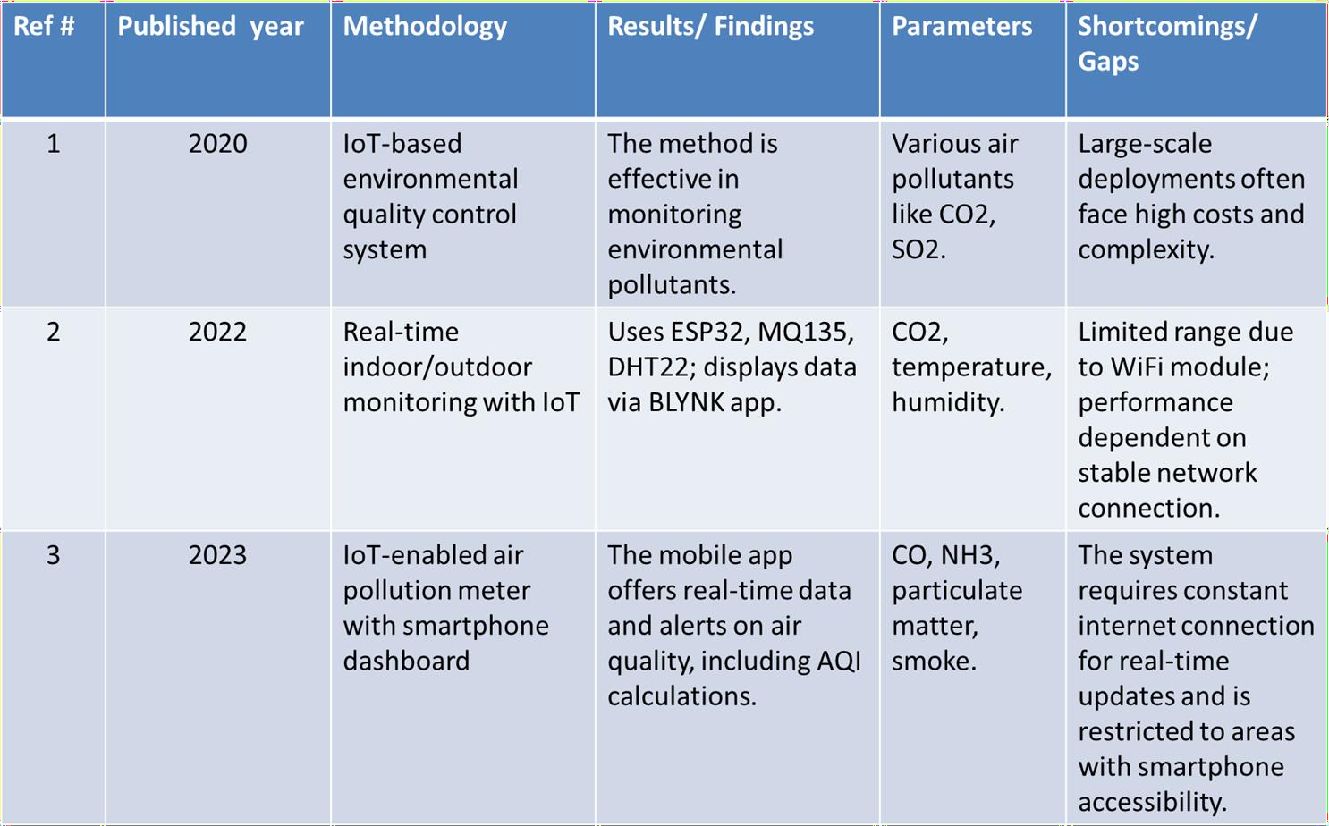
Literature Review
01/22/2025

Slide 8
Comparison Of Proposed System With Existing System:
Functionality | Proposed System | Existing System
 | Name | System name 1 | System name 2 | System name 3
Real-time monitoring | Yes | Yes | No | Yes
Data Accuracy | High | Medium | Low | Medium
Ease of use | Yes | No | Yes | No
Security | Yes | No | Yes | No
Alerts and Notification | Multiple Sensors Supported | Single Sensor | Single Sensor | Multiple Sensors Supported
Historical Data Analysis | Yes | No | No | Yes
Cost Efficiency | Moderate | High | Medium | Low
Scalability | High | Low | Medium | High
Maintenance Requiremen⁰t¹s^{/22} | Low /2025 | High | Medium | Low

Slide 9
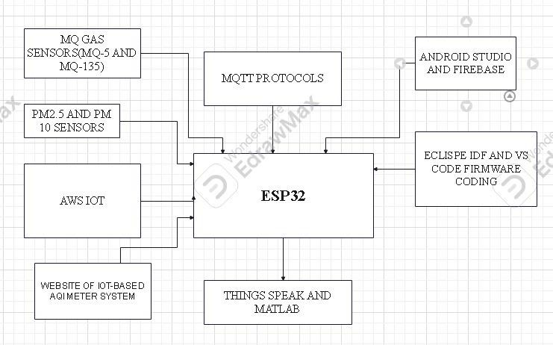
ARCHITECTURE DIAGRAM
01/22/2025
9

Slide 10
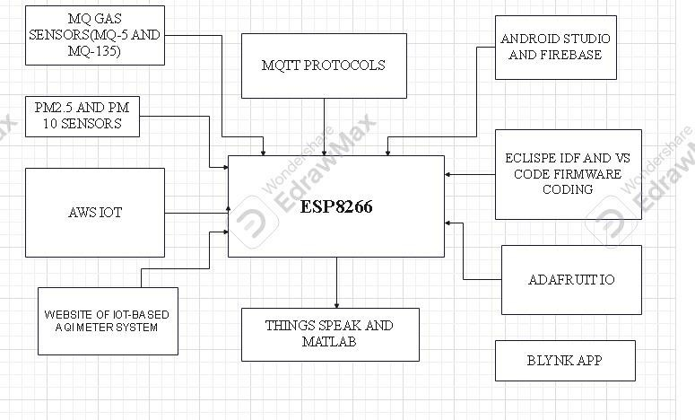
01/22/2025

Slide 11
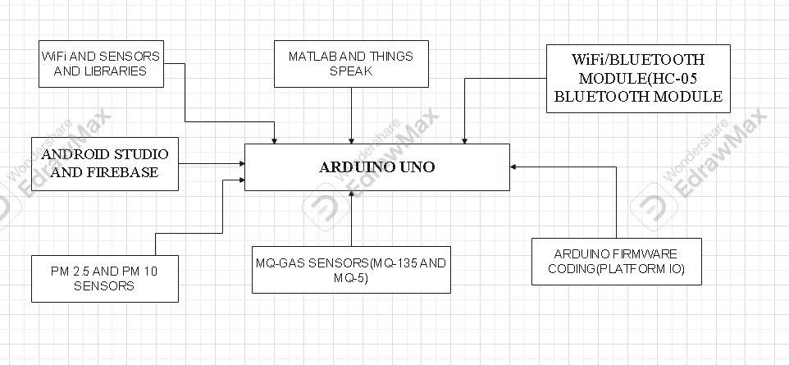
01/22/2025

Slide 12
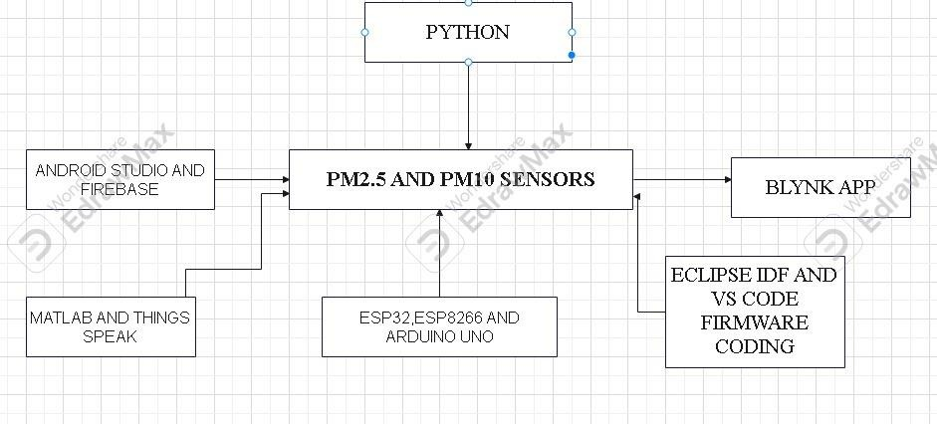
22/01/2025
12

Slide 13
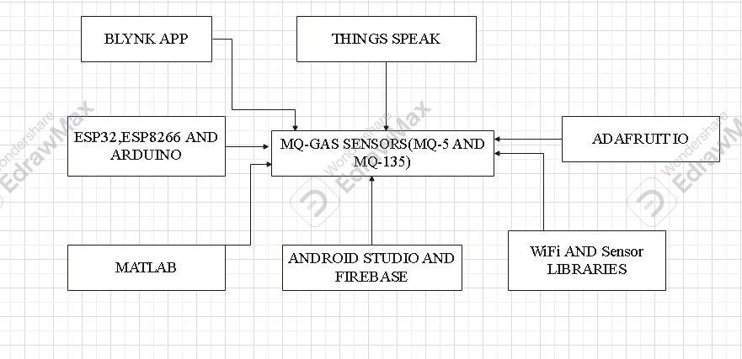
13
22/01/2025

Slide 14
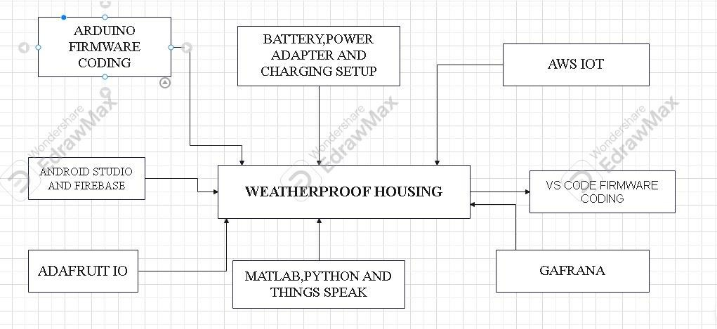
22/01/2025
14

Slide 15
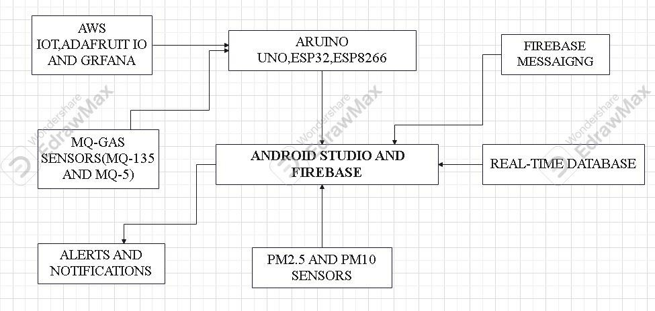
22/01/2025
15

Slide 16
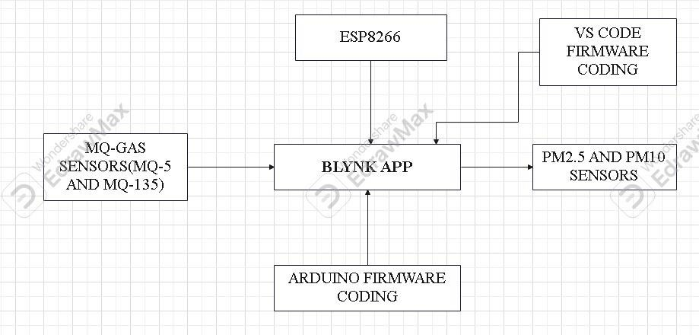
22/01/2025
16

Slide 17
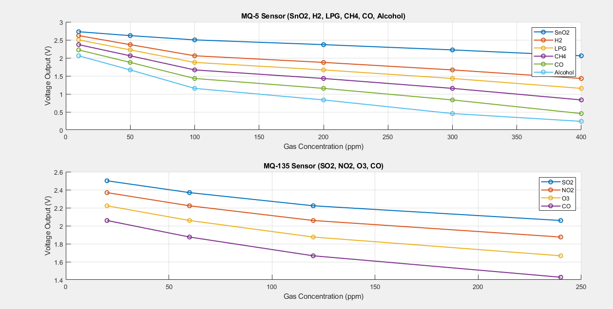
RESULTS
22/01/2025
17

Slide 18
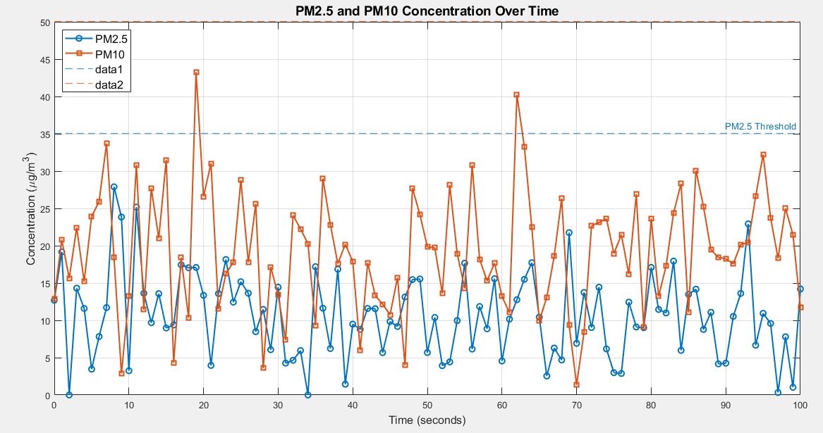

Slide 19
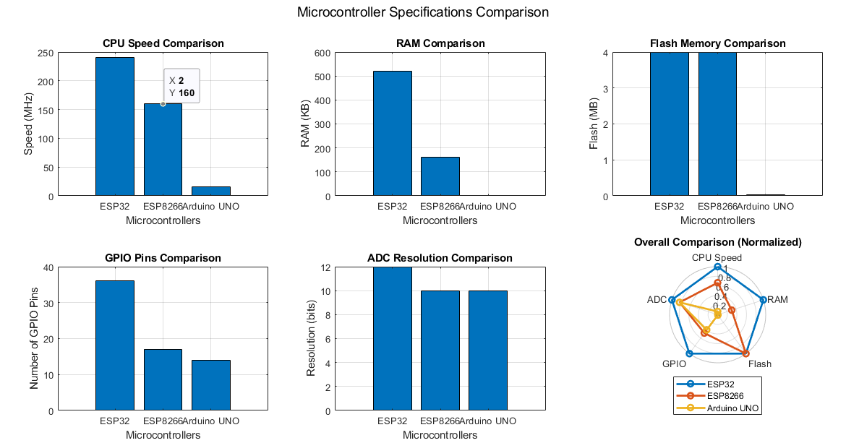

Slide 20
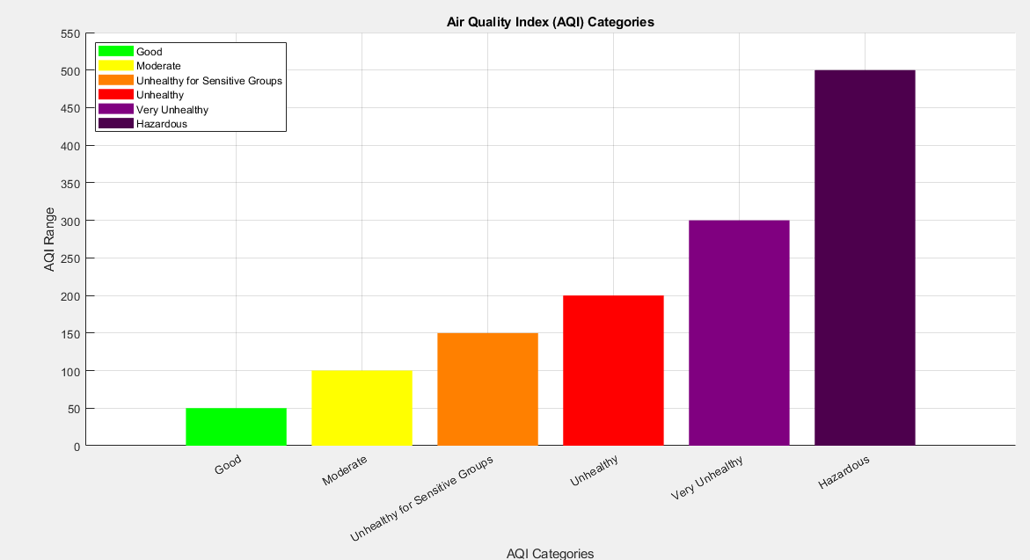

Slide 21
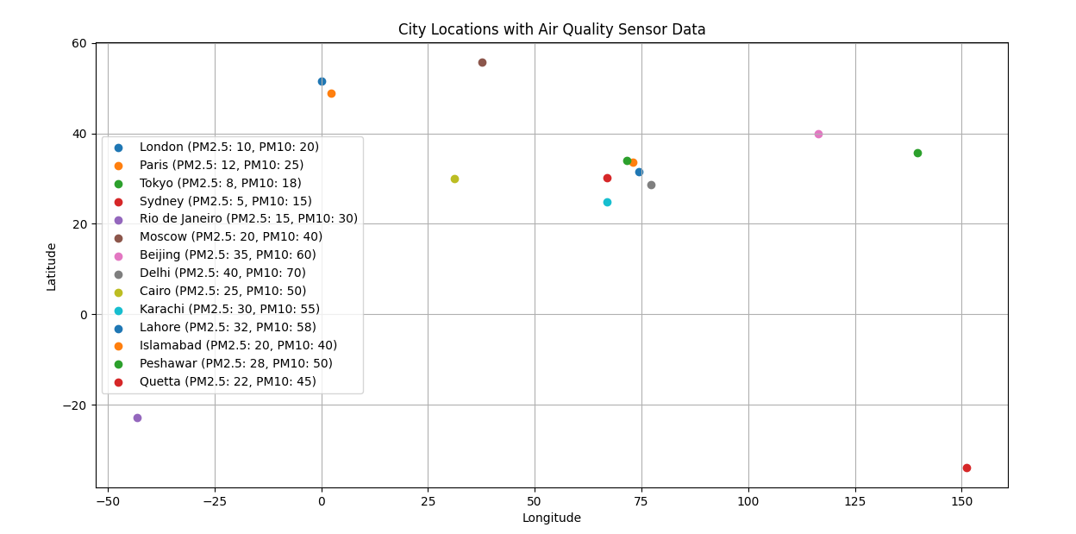

Slide 22
References
[1]
01/22/2025

Slide 23
References
01/22/2025

Slide 24
Thank You
24
01/22/2025

